Slide 1
Place based giving in London
How place based giving can help transform our boroughs
londonfunders.org.uk
JULY 2023

Slide 2
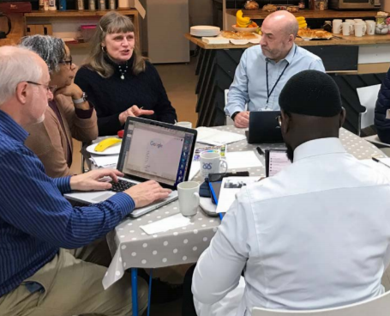
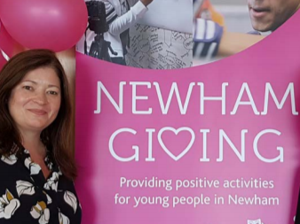
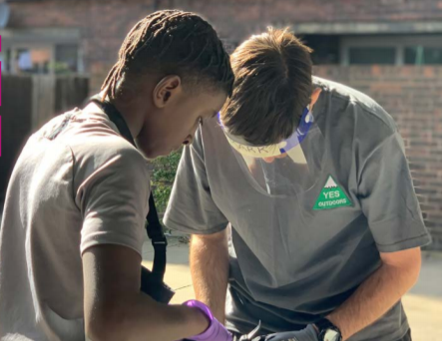
What is place based giving?
“The pandemic has changed how we think about place – our community, where we live and how we can contribute more to it. Everyone has something to give.”
Image credits (clockwise from top left)
Lewisham Local; Islington Giving; East End Community Foundation.

Slide 3
Key principles
Everyone has something to give. We share three principles:
We connect people and foster collaboration, bringing together residents and the public, private and the voluntary sectors
We empower local people to take action on the issues that affect them
We speak up about inequality and challenge ourselves and our partners to do better
‘It’s not what you do, it’s how you do it’.

Slide 4
What does it look like?

Slide 5
The current picture
https://londonsgiving.org.uk/giving-my-borough

Slide 6
The impact of place based giving*
Over the past 5 years, over £26.1m in grants has been distributed by the Givings
*This data was collected as part of the annual data collection undertaken by Rocket Science

Slide 7
Typical Giving ‘lifecycle’
First Interest
Local initiator opens conversations
Forming a partnership
Stakeholder meetings to establish Steering Group
Agreeing focus and structure
Outputs may include an MOU, need assessment, funding application and JD
Development
Development post reporting to Steering Group develops strategy
Launch and Testing
Implementation and consultation
Ongoing development and learning
e.g Grant distribution, review structure & governance, ongoing partnership development

Slide 8
What makes a good collaboration?
Membership: Breadth of expertise and experience - across sectors and the geography of the borough.
Allies
Influencers
Experts
Asset holders
Most of all - passion, energy, shared vision
The remit
Building trust
Voice
Quick wins / long-term ambition
Not just grant making – managing change
Independence and being seen to be independent
More information on the structure and Governance of Giving schemes can be found in our toolkit
https://londonsgiving.org.uk/introducing-place-based-giving/governance-toolkit

Slide 9
Five reflections from the past year
Back to the principles: it’s important these underpin whatever model and approach you take
More than grant-making: also the connections, partnerships and in-kind giving
‘People power’ & participant-led approaches: how can we make these more widespread?
Accelerating collaboration – relationships & trust
Diversity of local context: this is key when developing the right approach for your borough

Slide 10
More information
A Year of Giving – the latest impact report 2020/21
Map of current schemes https://londonsgiving.org.uk/giving-my-borough
helen.mathie@londonfunders.org.uk

Slide 11
Building a better London
London Funders is the only cross-sector membership network for funders and investors in London’s civil society.
020 7255 4488
Info@londonfunders.org.uk
londonfunders.org.uk

