Slide 1
Place based giving literature review
Understanding how place-based giving schemes are defined in recent literature
londonfunders.org.uk
August 2024

Slide 2
Methodology
Over the last two weeks we undertook a literature review to understand how place based giving schemes (PBGS) are defined in recent literature – mainly from organisations and people working on the implementation of PBGS in the UK.
48 texts were selected through the following steps
Review of existing literature within London Funders’ database.
Literature recommended by peers and professionals working in the sector.
Literature recommended by an academic working on the topic.
A thorough analysis was conducted of how they define PBGS, and major learning and gaps were identified.
Notes:
Janis Petzinger is a researcher at the Centre for the Study of Philanthropy and Public Good who has been exploring the world of philanthropy, particularly place based philanthropy and equitable and effective practices

Slide 3
Definition
Core principles
Existing literature on place based giving provides some guidance on defining the place based giving movement. It is driven by the following core principes
Collaboration – There's a strong emphasis on bringing together various stakeholders (residents, businesses, charities, public sector) to work collectively.
Community-Centric - Local people are empowered to identify needs and act on issues that matter to them.
Resource Mobilisation - Place-based giving goes beyond just money. It involves mobilising various resources like time, skills, connections, and in-kind donations.
Long-Term Commitment - These initiatives are characterised by a focus on building trust and working together for sustained positive change.

Slide 4
Definition
A collaborative approach to philanthropy
Literature also defines place based giving as a collaborative approach to philanthropy that devolved power to the people and democratises the resource allocation process
Focus on local needs - Addressing complex community issues requires collaboration across sectors and a deep understanding of the local context
Shared power and decision-making - Place-based giving emphasizes empowering local communities and relinquishing control by funders
Connectors and conveners - Schemes act as platforms for bringing people together and facilitating collaboration
Tackling inequality - A core aim is to address social injustices and build a more equitable society
Beyond grants - While grants are a component, place-based giving focuses on mobilising diverse resources and fostering innovative solutions

Slide 5
Overall, place-based giving is a collaborative approach to philanthropy that leverages local assets and empowers communities to address their own challenges.

Slide 6
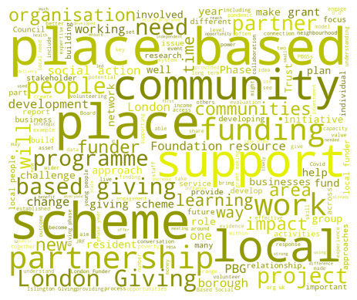
Word Cloud
Based on a word-frequency analysis of the 48 documents, the following descriptors were the most frequently used. The size of the words is correlated with the frequency of their usage.
The word cloud aligns with the review of place-based giving definitions which focus on community, people, partners based locally and discuss the importance of building trust-based partnerships for place-based giving schemes to thrive. Given that most the reviewed literature is London-based, the high usage of “London” as a term is also not surprising.

Slide 7
Context
The context of place based giving in the UK is deeply influenced by historical, economic and policy factors. The literature review highlighted:
Historical roots and development – historical background of PBGS and its modern evolution.
Economic and policy context – Impact of economic recession and austerity, the decline in community cohesion and policy shifts and localism.
Current landscape – diverse approaches and new models of giving

Slide 8
Learning
Key learning from place based giving schemes include:
Community engagement and local embeddedness
Collaboration and flexibility
Asset based approach
Building community resilience
Shifting power dynamics and participatory decision-making

Slide 9
Challenges
PBGS face several persistent challenges that hinder effectiveness. The key challenges notes were:
Policy flux
Reliance on short term funding
Power imbalance
Representation

Slide 10
Gaps in literature
The following gaps were identified in the literature
Long term impact assessment
Scalability of successful models
Quantitative DEI metrics
Integration of crisis management
Effectiveness/Impact measurement

Slide 11
Building a better London
London Funders is the only cross-sector membership network for funders and investors in London’s civil society.
020 7255 4488
Info@londonfunders.org.uk
londonfunders.org.uk

